Slide 1
String Instructions
String instructions were designed to operate on large data structures.
The SI and DI registers are used as pointers to the data structures being accessed or manipulated.
The operation of the dedicated registers stated above are used to simplify code and minimize its size.

Slide 2
String Instructions
The registers(DI,SI) are automatically incremented or decremented depending on the value of the direction flag:
  DF=0, increment SI, DI.
  DF=1, decrement SI, DI.
To set or clear the direction flag one should use the following instructions:
  CLD to clear the DF.
  STD to set the DF.

Slide 3
String Instructions
The REP/REPZ/REPNZ prefixes are used to repeat the operation it precedes.
String instructions we will discuss:
  LODS
  STOS
  MOVS
  CMPS
  SCAS

Slide 4
LODS/LODSB/LODSW/LODSD
Loads the AL, AX or EAX registers with the content of the memory byte, word or double word pointed to by SI relative to DS. After the transfer is made, the SI register is automatically updated as follows:
  SI is incremented if DF=0.
  SI is decremented if DF=1.

Slide 5
LODS/LODSB/LODSW/LODSD
Examples:
  LODSB
  AL=DS:[SI]; SI=SI ± 1
  LODSW
  AX=DS:[SI]; SI=SI ± 2
  LODSD
  EAX=DS:[SI]; SI=SI ± 4
  LODS MEAN
  AL=DS:[SI]; SI=SI ± 1 (if MEAN is a byte)
  LODS LIST
  AX=DS:[SI]; SI=SI ± 2 (if LIST is a word)
  LODS MAX
  EAX=DS:[SI]; SI=SI ± 4 (if MAX is a double word)

Slide 6
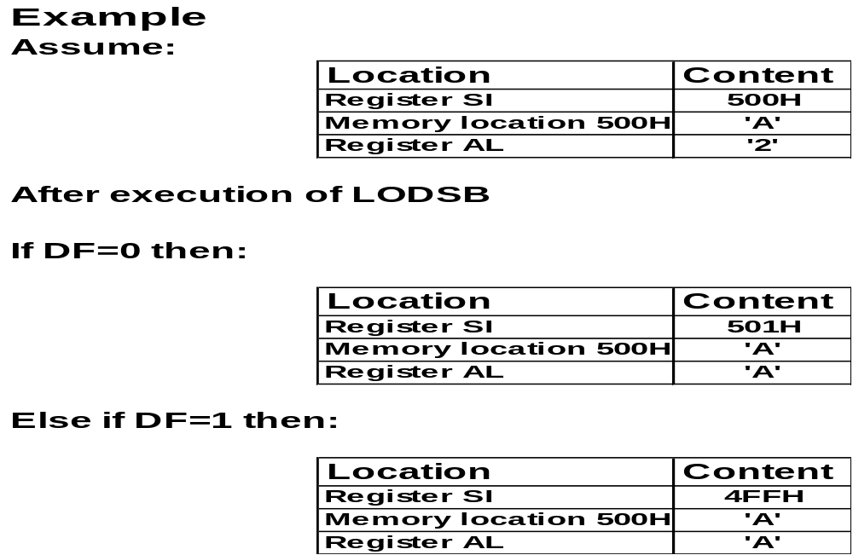
LODS/LODSB/LODSW/LODSD

Slide 7
STOS/STOSB/STOSW/STOSD
Transfers the contents of the AL, AX or EAX registers to the memory byte, word or double word pointed to by DI relative to ES. After the transfer is made, the DI register is automatically updated as follows:
  DI is incremented if DF=0.
  DI is decremented if DF=1.

Slide 8
STOS/STOSB/STOSW/STOSD
Examples:
  STOSB
  ES:[DI]=AL; DI=DI ± 1
  STOSW
  ES:[DI]=AX; DI=DI ± 2
  STOSD
  ES:[DI]=EAX; DI=DI ± 4
  STOS MEAN
  ES:[DI]=AL; DI=DI ± 1 (if MEAN is a byte)
  STOS LIST
  ES:[DI]=AX; DI=DI ± 2 (if LIST is a word)
  STOS MAX
  ES:[DI]=EAX; DI=DI ± 4 (if MAX is a double word)

Slide 9

STOS/STOSB/STOSW/STOSD

Slide 10
MOVS/MOVSB/MOVSW/MOVSD
Transfers the contents of the the memory byte, word or double word pointed to by SI relative to DS to the memory byte, word or double word pointed to by DI relative to ES. After the transfer is made, the DI register is automatically updated as follows:
  DI is incremented if DF=0.
  DI is decremented if DF=1.

Slide 11
MOVS/MOVSB/MOVSW/MOVSD
Examples:
  MOVSB
  ES:[DI]=DS:[SI]; DI=DI ± 1;SI=SI ± 1
  MOVSW
  ES:[DI]= DS:[SI]; DI=DI ± 2; SI=SI ± 2
  MOVSD
  ES:[DI]=DS:[SI]; DI=DI ± 4; SI=SI ± 4
  MOVS MEAN
  ES:[DI]=DS:[SI]; DI=DI ± 1; SI=SI ± 1 (if MEAN is a byte)
  MOVS LIST
  ES:[DI]=DS:[SI]; DI=DI ± 2; SI=SI ± 2 (if LIST is a word)
  MOVS MAX
  ES:[DI]=DS:[SI]; DI=DI ± 4; SI=SI ± 4 (if MAX is a double word)

Slide 12
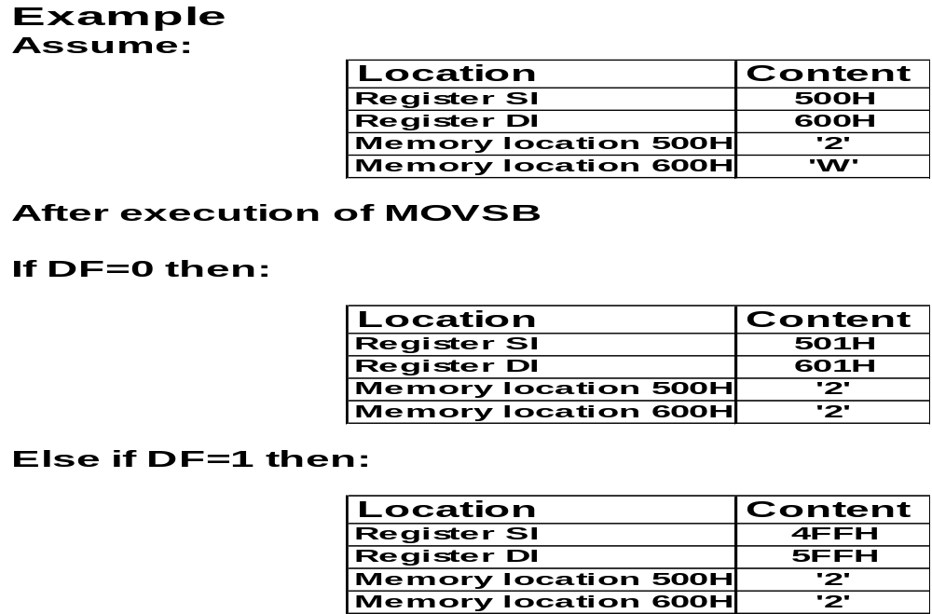
MOVS/MOVSB/MOVSW/MOVSD

Slide 13
CMPS/CMPSB/CMPSW/CMPSD
Compares the contents of the the memory byte, word or double word pointed to by SI relative to DS to the memory byte, word or double word pointed to by DI relative to ES and changes the flags accordingly. After the comparison is made, the DI and SI registers are automatically updated as follows:
  DI and SI are incremented if DF=0.
  DI and SI are decremented if DF=1.

Slide 14
SCAS/SCASB/SCASW/SCASD
Compares the contents of the AL, AX or EAX register with the memory byte, word or double word pointed to by DI relative to ES and changes the flags accordingly. After the comparison is made, the DI register is automatically updated as follows:
  DI is incremented if DF=0.
  DI is decremented if DF=1.

Slide 15
REP/REPZ/REPNZ
These prefixes cause the string instruction that follows them to be repeated the number of times in the count register ECX or until:
  ZF=0 in the case of REPZ (repeat while equal).
  ZF=1 in the case of REPNZ (repeat while not equal).

Slide 16
REP/REPZ/REPNZ
Use REPNE and SCASB to search for the character ‘f’ in the buffer given below.
BUFFER DB ‘EE3751’
MOV AL,’f’
LEA DI,BUFFER
MOV ECX,6
CLD
REPNE SCASB
JE FOUND

Slide 17
REP/REPZ/REPNZ
Use REPNE and SCASB to search for the character ‘3’ in the buffer given below.
BUFFER DB ‘EE3751’
MOV AL,’f’
LEA DI,BUFFER
MOV ECX,6
CLD
REPNE SCASB
JE FOUND

